Slide 1
COMP 3100
Week 3 - Monday

Slide 2
Last time
What did we talk about last time?
Requirements documents

Slide 3
Questions?

Slide 4
More on Requirements

Slide 5
Verifying and validating requirements in traditional processes
Traditional processes depend on requirements being right
The following characteristics should be checked:
  Clarity: Are the requirements clear (testable)?
  Consistency: Are there any contradictions?
  Completeness: Is everything covered in sufficient detail?
  Correctness: Do the requirements reflect what stakeholders want?
  Well-formedness: Are the requirements formatted correctly? (Uniquely labeled atomic requirements using "must" and "shall")
Reviews are the process of having various people check the requirements for these characteristics

Slide 6
Verifying and validating requirements in agile processes
Requirements are always under scrutiny in agile processes
  Someone is always updating and prioritizing the product backlog
  Requirements are checked at the end of each sprint
If the current version of the product behaves incorrectly, it might mean that the requirements are incorrect
Unfortunately, you need someone who can recognize the errors at the sprint reviews

Slide 7
Requirements management in traditional processes
Projects start with a product mission statement giving business requirements
Requirements analysis is the process of gathering stakeholder needs and using them to turn the mission statement into a list of requirements specifications
The result is a document called a software requirements specification (SRS)
  This is what you've got to create for Project 1

Slide 8
Book outline for an SRS
Introduction
  Product Vision
  Project Scope
  Stakeholders
  Design and Implementation Constraints
Functional Requirements
  Product Behavior
  User Interfaces
  System Interface
  Data Requirements
Non-Functional Requirements
Other Requirements
Glossary

Slide 9
Project 1 outline for SRS
Introduction
  Purpose of Document
  Intended Audience
  Scope
  Definitions and Terminology
Overall Description
  Product Functions
  User Characteristics
  Dependencies
Interfaces
  User interfaces
  Hardware interfaces
  Software interfaces
  Communications interfaces
Functional Requirements
Non-functional Requirements

Slide 10
Requirements management in agile processes
The mission statement or other high-level needs are used to writer big user stories
Working with stakeholders, the team refines sprintable stories into operational-level and physical-level requirements
The product owner has the responsibility to update the product backlog as the product evolves

Slide 11
Requirements vs. product design
Most industries call requirements analysis "product design"
A lot of other industries design things, but software developers tend not to use the same tools they do
  Maybe just because we don't call it product design
It might be more helpful to think about requirements analysis in terms of design
  Many designs are possible
  It's smart to come up with several alternatives to see which ones people like best
  Designing is a more active mindset than gathering requirements
Like other problem-solving activities, requirements analysis should involve:
  Trial and error
  Iteration
  Recognition that there isn't a unique solution

Slide 12
Requirements modeling
When software engineers say modeling, they usually mean drawing diagrams
Requirements modeling is making representations (diagrams) that help you understand your requirements
Both traditional and agile processes use models
The Unified Modeling Language (UML) is the most common set of standards for representing such models
Some developers use models extensively, and others use them rarely

Slide 13
Kinds of requirements modeling
Model | Show | Typical UML Diagram
Use Case Models | A product interacting with its environment, often actors who take on roles | Use Case Diagram
Conceptual Models | Relationships between entities | Class Diagram
State Diagrams | The states a product can be in and the transitions between those states | State Diagram
Decision Trees and Tables | What a product should do under various conditions | Activity Diagram
Data Flow Diagrams | How data enters, is processed, and leaves the product | Activity Diagram or Sequence Diagram

Slide 14
UML

Slide 15
Modeling
At both the requirements stage and the design stage, modeling can be useful
Modeling mostly means drawing boxes and arrows
We want high-level descriptions of:
  What the thing is supposed to do
  What parts it's composed of
  How it does what it does

Slide 16
System modeling
Models leave out details
Models are useful to help understand a complex system
  During requirements engineering, models clarify what an existing system does
  Or models could be used to plan out a new system
Models can represent different perspectives of a system:
  External: the context of a system
  Interaction: the interactions within the system or between it and the outside
  Structural: organization of a system
  Behavior: how the system responds to events

Slide 17
UML
The Unified Modeling Language (UML) is an international standard for graphical models of software systems
A few useful kinds of diagrams:
  Activity diagrams
  Use case diagrams
  Sequence diagrams
  State diagrams
Class diagrams are important enough that we'll talk about them in greater detail

Slide 18
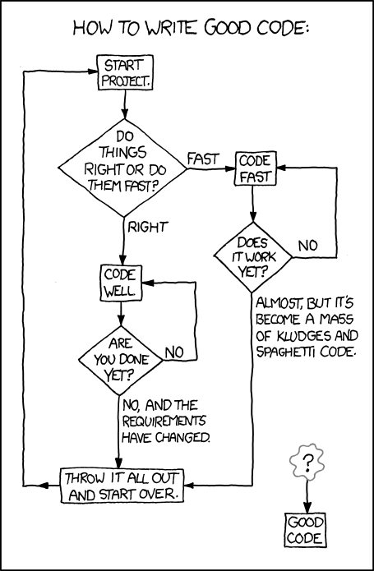
Activity diagrams
Activity diagrams show the workflow of actions that a system takes
XKCD of an activity diagram for writing good code
  From: https://xkcd.com/844/
Formally:
  Rounded rectangles represent actions
  Diamonds represent decisions
  Bars represent starting or ending concurrent activities
  A black circle represents the start
  An encircled black circle represents the end

Slide 19
More detailed activity model

Slide 20
Data-driven modeling
Data-driven models show how input data is processed to generate output data
The following is an activity diagram that shows how blood sugar data is processed by a system to deliver the right amount of insulin

Slide 21
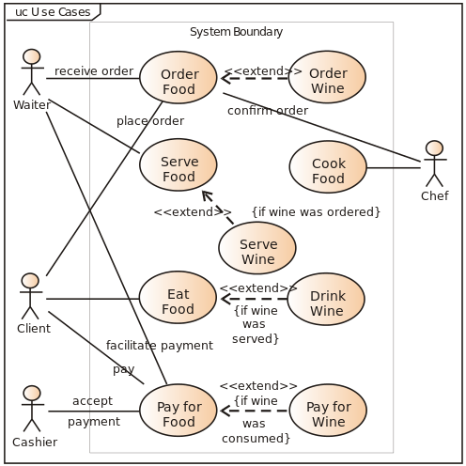
Use case diagrams
Use case diagrams show relationships between users of a system and different use cases where the user is involved
Example from Wikipedia:

Slide 22
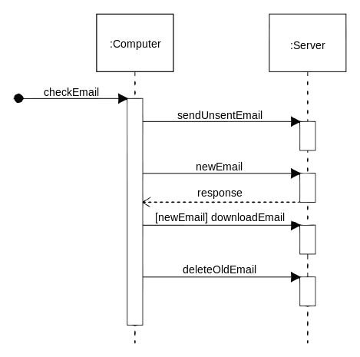
Sequence diagrams
Sequence diagrams show system object interactions over time
These messages are visualized as arrows
  Solid arrow heads are synchronous messages
  Open arrow heads are asynchronous messages
  Dashed lines represent replies
Example from Wikipedia:

Slide 23
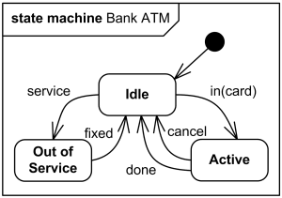
State diagrams
State diagrams are the UML generalization of finite state automata from discrete math
They describe a series of states that a system can be in and how transitions between those states happen
Example from uml-diagrams.org:

Slide 24
Event-driven modeling
Event-driven modeling is another kind of behavioral modeling that focuses on how a system responds to events rather than on processing a stream of data
Here's a state diagram for a microwave oven based on various outside events

Slide 25
Class Diagrams

Slide 26
Structural models
Structural models show how a system is organized in terms of its components and their relationships
UML class diagrams are used for structural models, but they can be used in many different ways:
  Relationships
  Generalization
  Aggregation

Slide 27
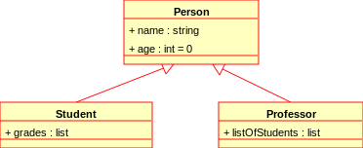
Class diagrams
Class diagrams show many kinds of relationships
The classes being described often (but not always) map to classes in object-oriented languages
The following symbols are used to mark class members:
  + Public
  - Private
  # Protected
  / Derived
  ~ Package
  * Random
Example from Wikipedia:

Slide 28
Relationships
Associations between classes can be drawn with a line in a class diagram
Notations can be used to mark relationships as one to one, many to one, many to many, etc.
These kinds of relationships are particularly important when designing a database

Slide 29
Generalization
Classes can be listed with their attributes
However, there are often classes that share attributes with each other
Some classes are specialized versions of other classes, with more attributes and abilities
This relationship between general classes and more specialized classes is handled in Java by the mechanic of inheritance

Slide 30
Aggregation
Another way of using class diagrams is to show that some objects or classes are made up of smaller parts represented by other classes
A diamond shape is used to mark a class that is the whole, and its parts are connected to the diamond

Slide 31
Upcoming

Slide 32
Next time…
Read Chapter 2

Slide 33


SCAN the QR CODE to REGISTER

Slide 34
Reminders
Read Chapter 2: Software Processes for Wednesday
Keep working on your projects
  SRS draft due Friday!

